Slide 1
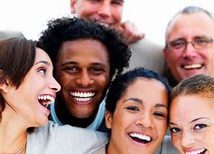
At the start of a new yew we make resolution to change.
What happens
Where does that desire go.

Slide 2
We try to do or be “better”, we realy want to change and we give an honest effort. What happens, is this habit or is this something different.
We are people of Habit

Slide 3
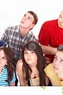
Human nature
We struggle daily. We not only have Habits Hang-ups and Hurts we struggle with ourselves the one that has unlimited wants and a “need” for self.

Slide 4
Romans 7:15 Amplified Bible (AMP)
¹⁵ For I do not understand my own actions [I am baffled and bewildered by them]. I do not practice what I want to do, but I am doing the very thing I hate [and yielding to my human nature, my worldliness—my sinful capacity].
Romans 7;15

Slide 5
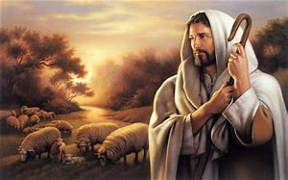
Are we helpless

Slide 6
"I Can Do All Things Through Christ Who Strengthens Me"
Philippians 4:13
We have HOPE

